Slide 1


Raj Nair
15/08/2024

Slide 2

Outline
Executive Summary
Introduction
Methodology
Results
Conclusion
Appendix

Slide 3
Executive Summary
Summary of methodologies
- Data collection
- Data wrangling
- Exploratory Data Analysis with Data Visualization
- Exploratory Data Analysis with SQL
- Building an interactive map with Folium
- Building a Dashboard with Plotly Dash
- Predictive analysis (Classification)
Summary of all results
- Exploratory Data Analysis results
- Interactive analytics demo in screenshots
- Predictive analysis results

Slide 4
Introduction
Project background and context
SpaceX is the most successful company of the commercial space age, making space travel affordable. The company advertises Falcon 9 rocket launches on its website, with a cost of 62 million dollars; other providers cost upward of 165 million dollars each, much of the savings is because SpaceX can reuse the first stage. Therefore, if we can determine if the first stage will land, we can determine the cost of a launch. Based on public information and machine learning models, we are going to predict if SpaceX will reuse the first stage.
Problems you want to find answers
- How do variables such as payload mass, launch site, number of flights, and orbits affect the
success of the first stage landing?
- Does the rate of successful landings increase over the years?
- What is the best algorithm that can be used for binary classification in this case?

Slide 5

Section 1

Slide 6
Methodology
Executive Summary
Data collection methodology:
Using SpaceX Rest API
Using Web Scrapping from Wikipedia
Perform data wrangling
Filtering the data
Dealing with missing values
Using One Hot Encoding to prepare the data to a binary classification
Perform exploratory data analysis (EDA) using visualization and SQL
Perform interactive visual analytics using Folium and Plotly Dash
Perform predictive analysis using classification models

Slide 7
Data Collection
Data collection process involved a combination of API requests from SpaceX REST API and Web Scraping data from a table in SpaceX’s Wikipedia entry. We had to use both of these data collection methods in order to get complete information about the launches for a more detailed analysis.
Data Columns obtained by using SpaceX REST API:
FlightNumber, Date, BoosterVersion, PayloadMass, Orbit, LaunchSite, Outcome, Flights, GridFins, Reused, Legs, LandingPad, Block, ReusedCount, Serial, Longitude, Latitude
Data Columns obtained by using Wikipedia Web Scraping:
Flight No., Launch site, Payload, PayloadMass, Orbit, Customer, Launch outcome, Version Booster, Booster landing, Date, Time

Slide 8
Data Collection – SpaceX API
Requesting rocket launch data from SpaceX API
Decoding the response content using .json() and turning it into a dataframe using .json_normalize()
Requesting needed information about the launches from SpaceX API by applying custom functions
Constructing data we have obtained into a dictionary
Creating a dataframe from the dictionary
Filtering the dataframe to only include Falcon 9 launches
Replacing missing values of Payload Mass column with calculated .mean() for this column
Exporting the data to CSV
Github link Data Collection-SpaceX API

Slide 9
Data Collection - Scraping
Requesting Falcon 9 launch data from Wikipedia
Creating a BeautifulSoup object from the HTML response
Extracting all column names from the HTML table header
Collecting the data by parsing HTML tables
Constructing data we have obtained into a dictionary
Creating a dataframe from dictionary
Exporting the data to CSV
Github link: Data Collection-Scraping

Slide 10
Data Wrangling
In the data set, there are several different cases where the booster did not land successfully. Sometimes a landing was attempted but failed due to an accident; for example, True Ocean means the mission outcome was successfully landed to a specific region of the ocean while False Ocean means the mission outcome was unsuccessfully landed to a specific region of the ocean.
True RTLS means the mission outcome was successfully landed to a ground pad False RTLS means the mission outcome was unsuccessfully landed to a ground pad.
True ASDS means the mission outcome was successfully landed on a drone ship False ASDS means the mission outcome was unsuccessfully landed on a drone ship.
We mainly convert those outcomes into Training Labels with “1” means the booster successfully landed, “0” means it was unsuccessful.
Github link: Data Wrangling

Slide 11
EDA with Data Visualization
Charts were plotted:
Flight Number vs. Payload Mass, Flight Number vs. Launch Site, Payload Mass vs. Launch Site, Orbit Type vs. Success Rate, Flight Number vs. Orbit Type, Payload Mass vs Orbit Type and Success Rate Yearly Trend
Scatter plots show the relationship between variables. If a relationship exists, they could be used in machine learning model.
Bar charts show comparisons among discrete categories. The goal is to show the relationship between the specific categories being compared and a measured value.
Line charts show trends in data over time (time series).
Github link: EDA with Data Visualization

Slide 12
EDA with SQL
Performed SQL queries:
Displaying the names of the unique launch sites in the space mission.
Displaying 5 records where launch sites begin with the string 'CCA'.
Displaying the total payload mass carried by boosters launched by NASA (CRS)
Displaying average payload mass carried by booster version F9 v1.1
Listing the date when the first successful landing outcome in ground pad was achieved
Listing the names of the boosters which have success in drone ship and have payload mass greater than 4000 but less than 6000
Listing the total number of successful and failure mission outcomes
Listing the names of the booster versions which have carried the maximum payload mass
Listing the failed landing outcomes in drone ship, their booster versions and launch site names for the months in year 2015
Ranking the count of landing outcomes (such as Failure (drone ship) or Success (ground pad)) between the date 2010-06-04 and 2017-03-20 in descending order
Github link: EDA with SQL

Slide 13
Build an Interactive Map with Folium
Markers of all Launch Sites:
-Added Marker with Circle, Popup Label and Text Label of NASA Johnson Space Center using its latitude and longitude coordinates as a start location.
- Added Markers with Circle, Popup Label and Text Label of all Launch Sites using their latitude and longitude coordinates to show their geographical locations and proximity to Equator and coasts
Added coloured Markers of success (Green) and failed (Red) launches using Marker Cluster to identify which launch sites have relatively high success rates.
Github link :Interactive Map with Folium

Slide 14
Build a Dashboard with Plotly Dash
Added a dropdown list to enable Launch Site selection.
Added a pie chart to show the total successful launches count for all sites and the Success vs. Failed counts for the site, if a specific Launch Site was selected.
Added a slider to select Payload range.
Added a scatter chart to show the correlation between Payload and Launch Success.
Github link: Dashboard with Plotly Dash

Slide 15
Predictive Analysis (Classification)
Creating a NumPy array from the column “Class” in data
Standardizing the data with StandardScaler, then fitting and transforming it
Splitting the data into training and testing sets with train_test_split function
Creating a GridSearchCV object with cv = 10 to find the best parameters
Applying GridSearchCV on LogReg, SVM, Decision Tree, and KNN models
Calculating the accuracy on the test data using the method .score() for all models
Examining the confusion matrix for all models
Finding the method performs best by examining the Jaccard_score and F1_score metrics
Github link: Predictive Analytics

Slide 16
Results
Exploratory data analysis results
Interactive analytics demo in screenshots
Predictive analysis results

Slide 17

Section 2

Slide 18
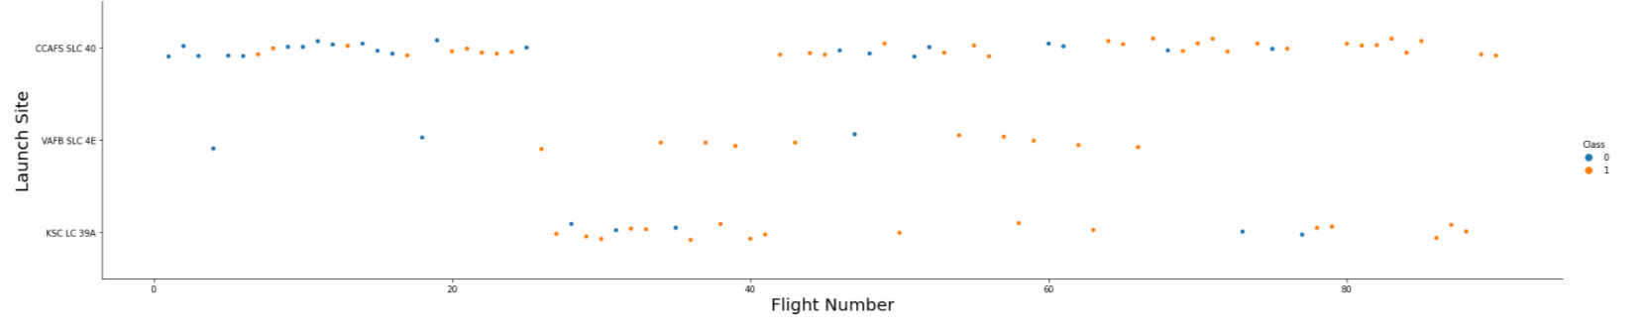
Flight Number vs. Launch Site
The earliest flights all failed while the latest flights all succeeded.
The CCAFS SLC 40 launch site has about a half of all launches.
VAFB SLC 4E and KSC LC 39A have higher success rates.
It can be assumed that each new launch has a higher rate of success.

Slide 19
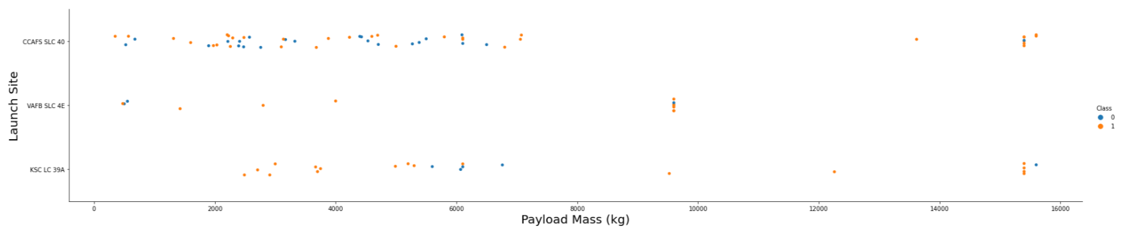
Payload vs. Launch Site
For every launch site the higher the payload mass, the higher the success rate.
Most of the launches with payload mass over 7000 kg were successful.
KSC LC 39A has a 100% success rate for payload mass under 5500 kg too.

Slide 20
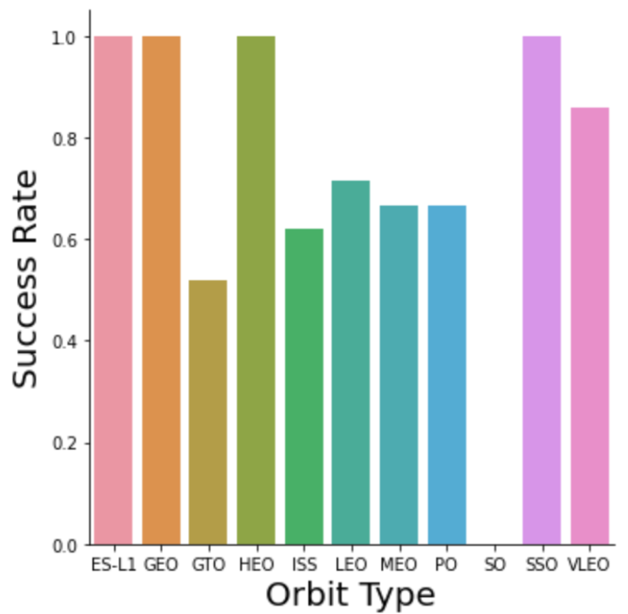
Success Rate vs. Orbit Type
Orbits with 100% success rate:
- ES-L1, GEO, HEO, SSO
Orbits with 0% success rate:
- SO
Orbits with success rate between 50% and 85%:
- GTO, ISS, LEO, MEO, PO

Slide 21
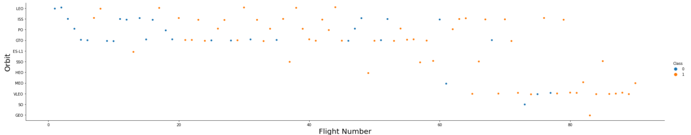
Flight Number vs. Orbit Type
In the LEO orbit the Success appears related to the number of flights; on the other hand, there seems to be no relationship between flight number when in GTO orbit.

Slide 22
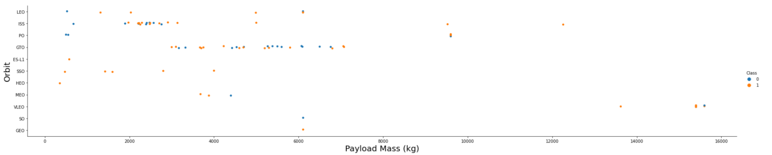
Payload vs. Orbit Type
Heavy payloads have a negative influence on GTO orbits and positive on GEO and Polar LEO (ISS) orbits.

Slide 23
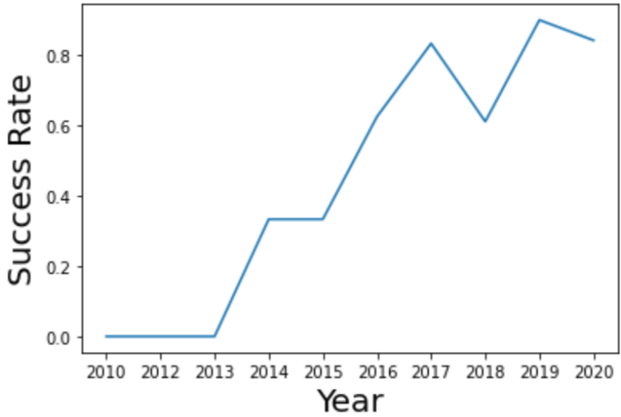
Launch Success Yearly Trend
The success rate since 2013 kept increasing till 2020

Slide 24
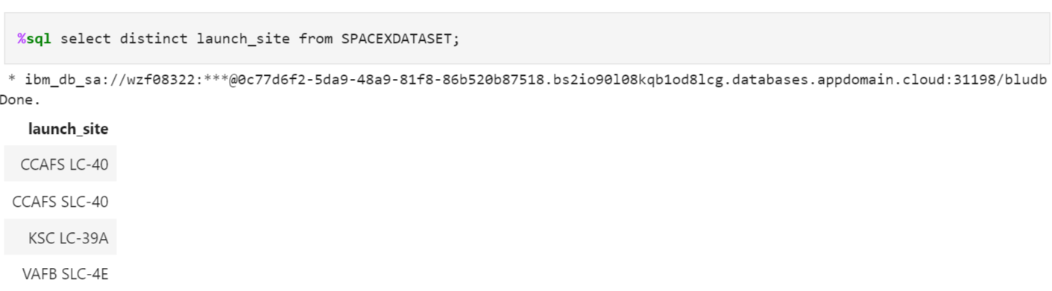
All Launch Site Names
Names of Launch Sites

Slide 25
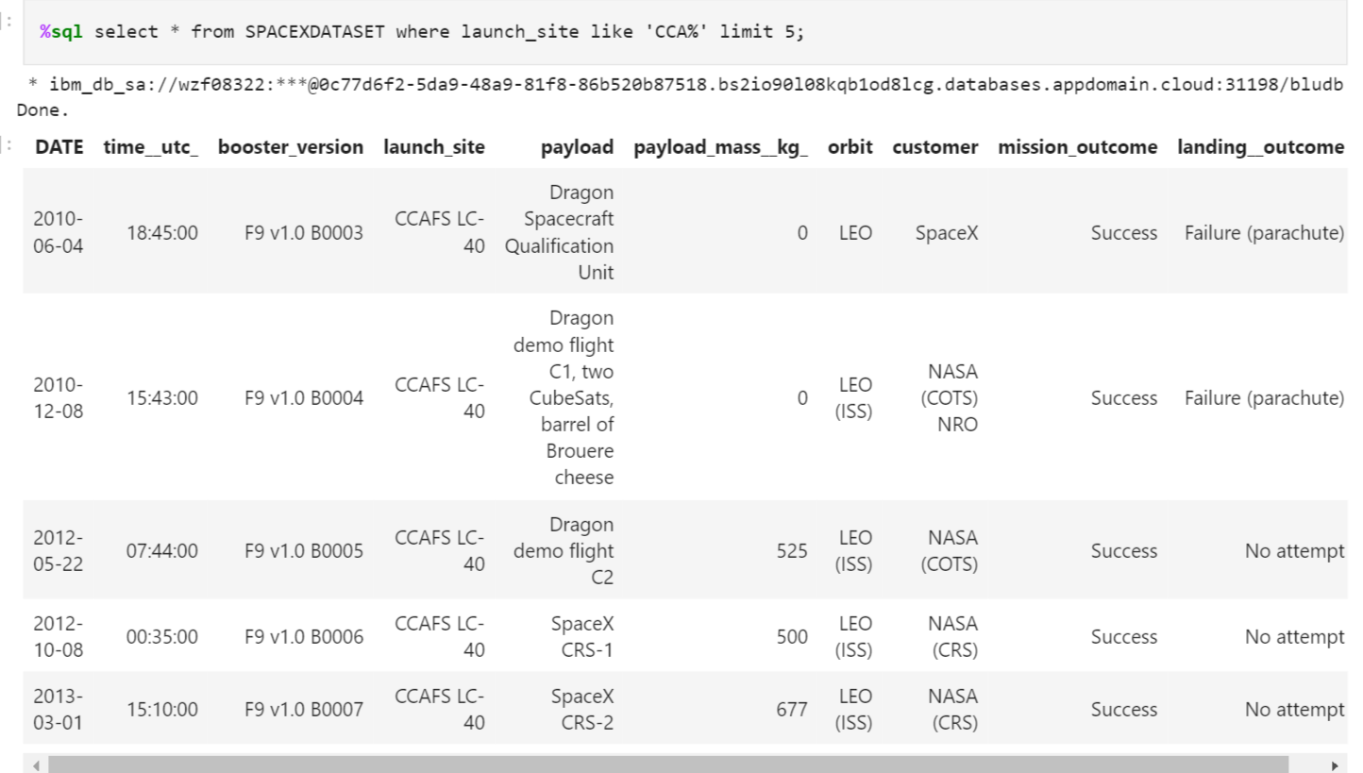
Launch Site Names Begin with 'CCA'
Names of launch sites whose name begin with CCA

Slide 26
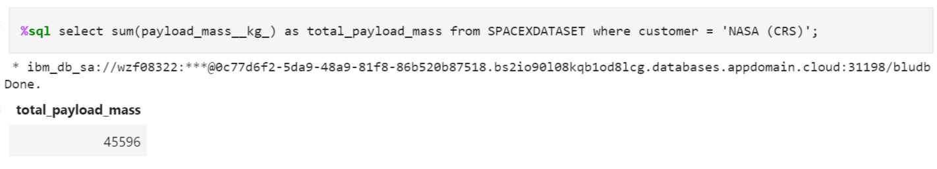
Total Payload Mass
Total payload mass is 45,596 KG

Slide 27
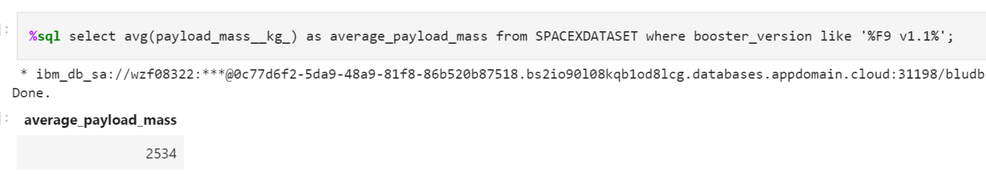
Average Payload Mass by F9 v1.1
Average payload mass carried by F9 V1.1 is 2,534 KG

Slide 28
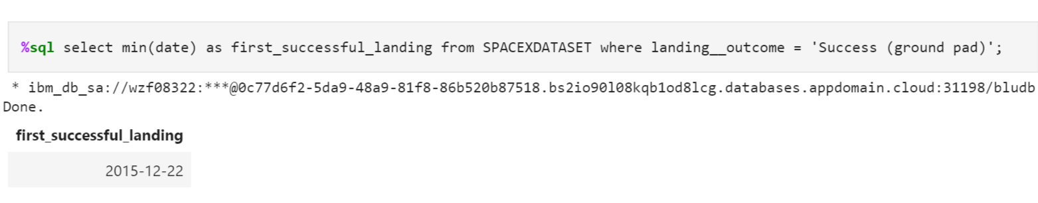
First Successful Ground Landing Date
First successful ground landing was achieved on 22nd December 2015

Slide 29
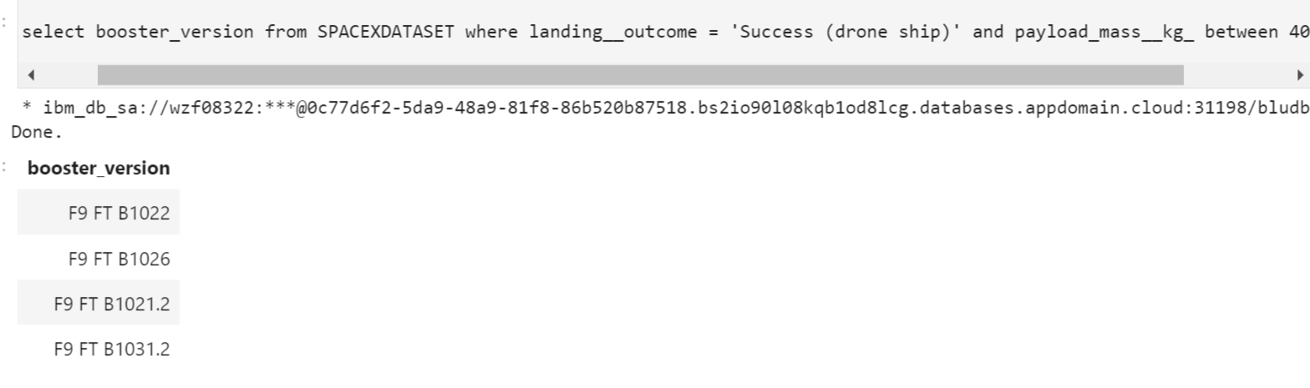
Successful Drone Ship Landing with Payload between 4000 and 6000
Following are the successful drone ship landing with payload between 4000 and 5000

Slide 30
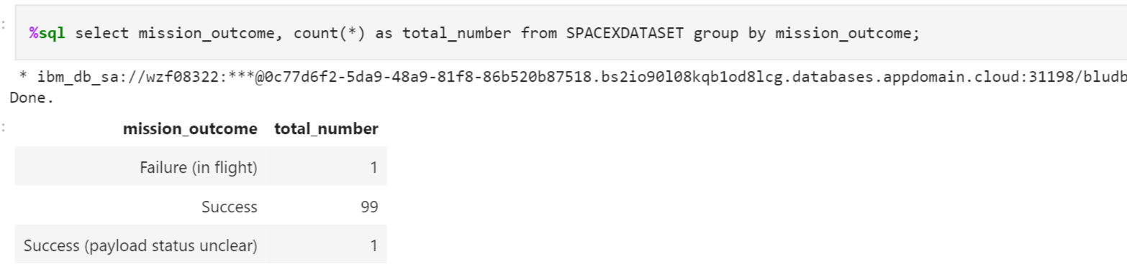
Total Number of Successful and Failure Mission Outcomes
Failed mission outcomes : 1
Success : 99
Payload status unclear : 1

Slide 31
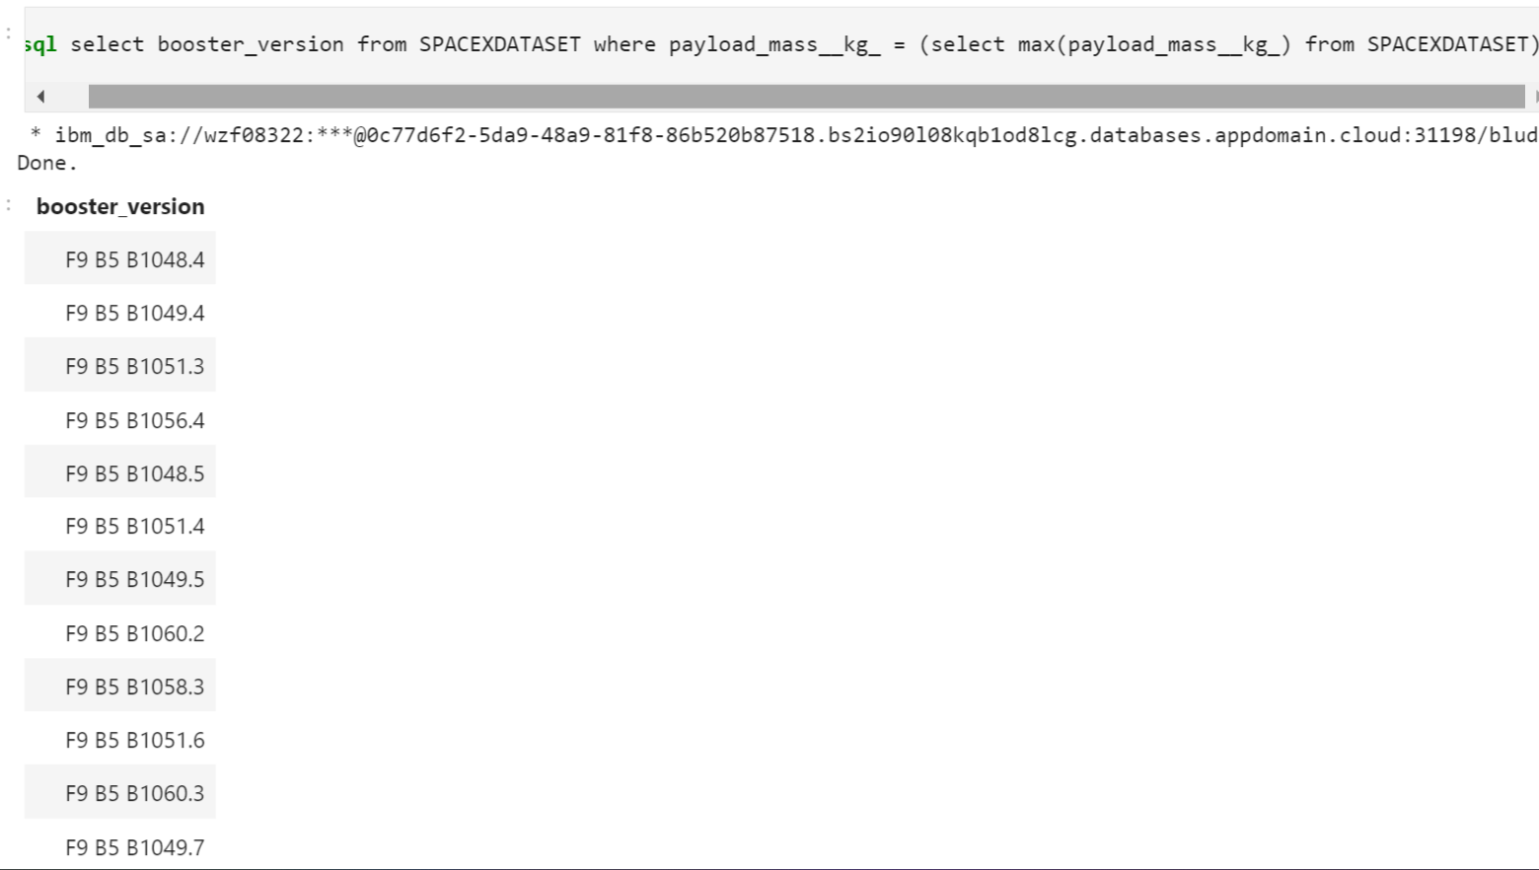
Boosters Carried Maximum Payload
Following are the names of Boosters that carried Maximum payload

Slide 32
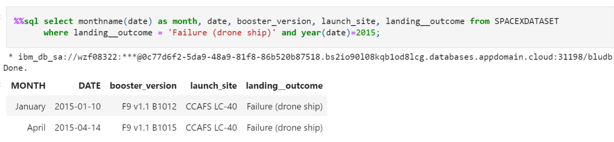
2015 Launch Records
Following are the failed landing outcomes for the year 2015

Slide 33
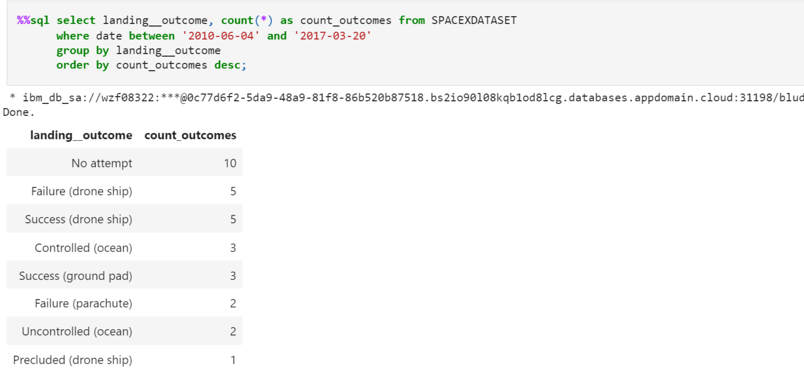
Landing Outcomes Between 2010-06-04 and 2017-03-20
Following are the landing outcomes ranked from 4th June 2010 to 20th March 2017

Slide 34

Section 3

Slide 35
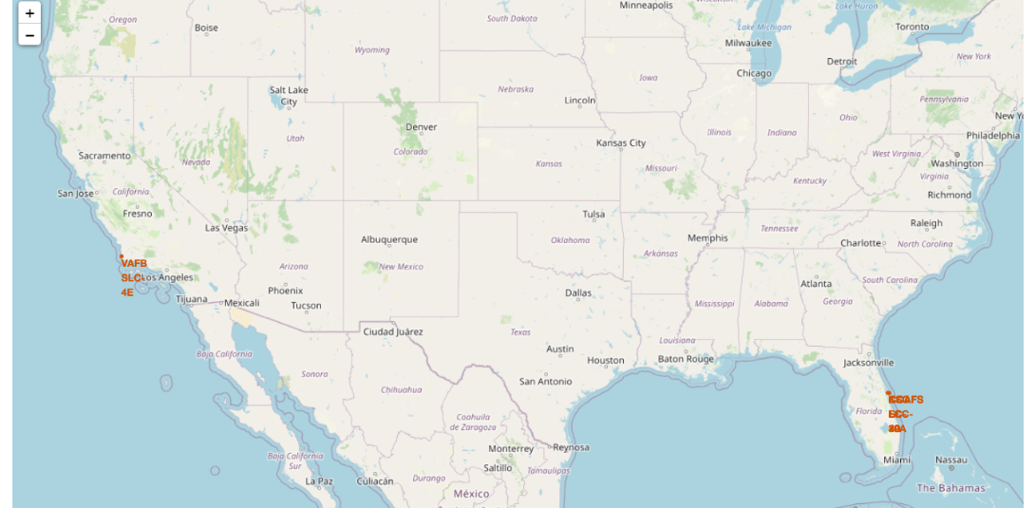
Launch Sites marked on map
Most of Launch sites are in proximity to the Equator line. The land is moving faster at the equator than any other place on the surface of the Earth. Anything on the surface of the Earth at the equator is already moving at 1670 km/hour. If a ship is launched from the equator it goes up into space, and it is also moving around the Earth at the same speed it was moving before launching. This is because of inertia. This speed will help the spacecraft keep up a good enough speed to stay in orbit.
All launch sites are in very close proximity to the coast, while launching rockets towards the ocean it minimises the risk of having any debris dropping or exploding near people.

Slide 36
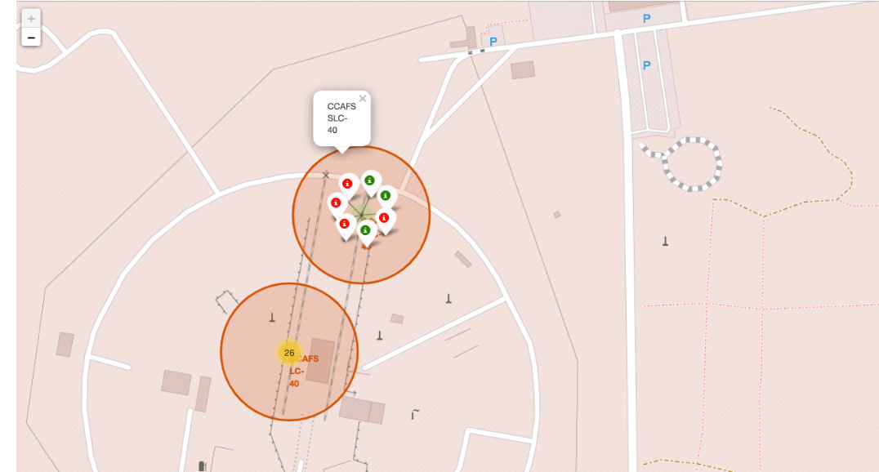
Launch records on the map
From the color-labeled markers we should be able to easily identify which launch sites have relatively high success rates.
Red marker =Failed Launch
Green marker = Successful Launch
Launch site CCAFS SLC-40 has high failure rate

Slide 37
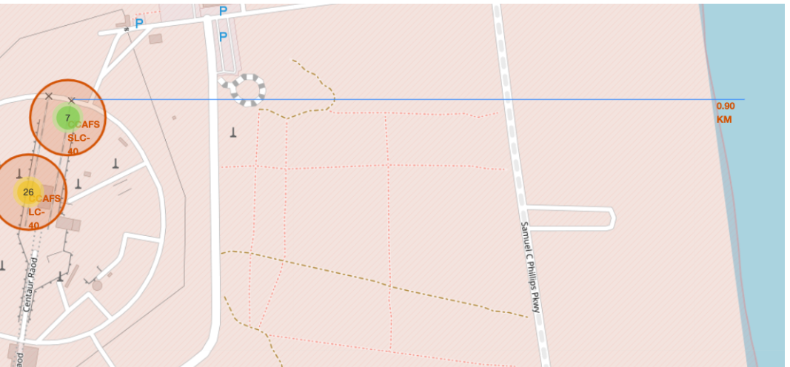
CCAFS LC-40 to its coastline
Distance of coastline from launch site CCAFS LC-40 is 0.90KM

Slide 38

Section 4

Slide 39
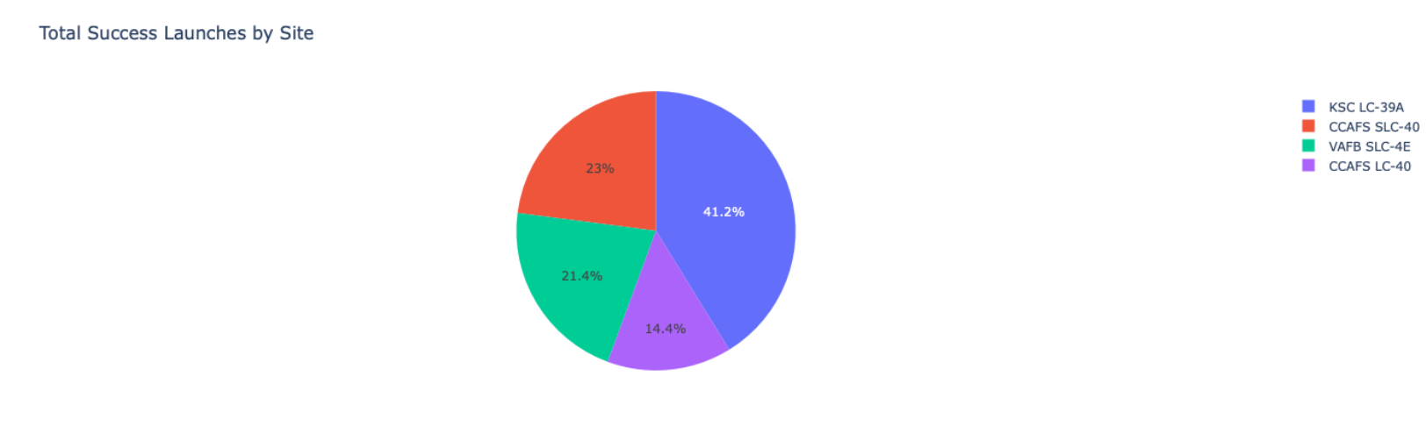
Launch Success-count Pie-Chart
The launch site KSC LC-39A has the highest successful launches

Slide 40
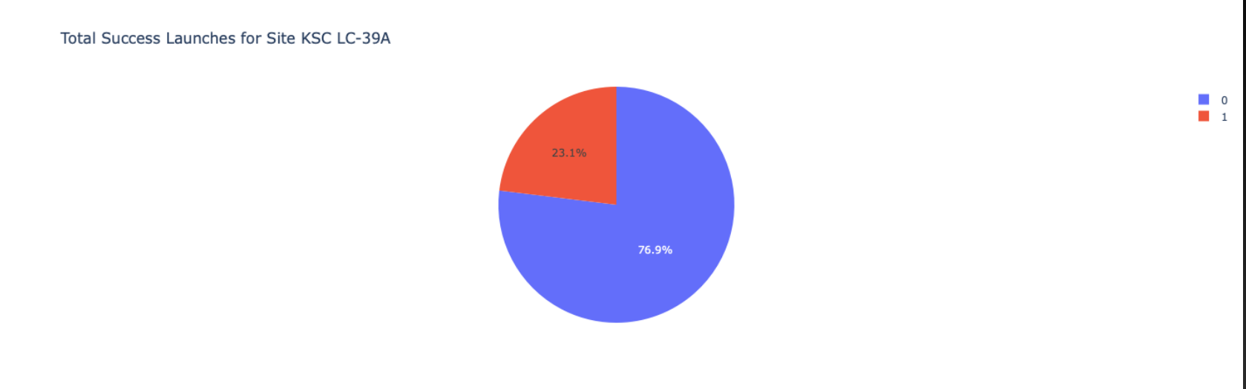
Launch site with highest launch success ratio
KSC LC-39A has the highest launch success rate (76.9%) with 10 successful and only 3 failed landings.

Slide 41
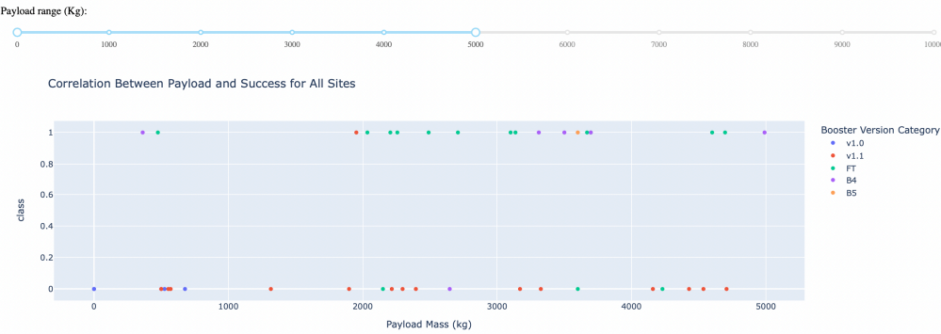
Payload Mass v/s Launch Outcome
We can infer from the chart that payloads between 2000 and 5500 kg have the highest success rate.

Slide 42

Section 5

Slide 43
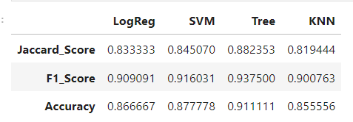
Classification Accuracy
From the above dataframe, we can observe that DecisionTree outperforms every other model in the following metrics.
Thus we can infer that , Decision Tree is the best model for the dataset used

Slide 44
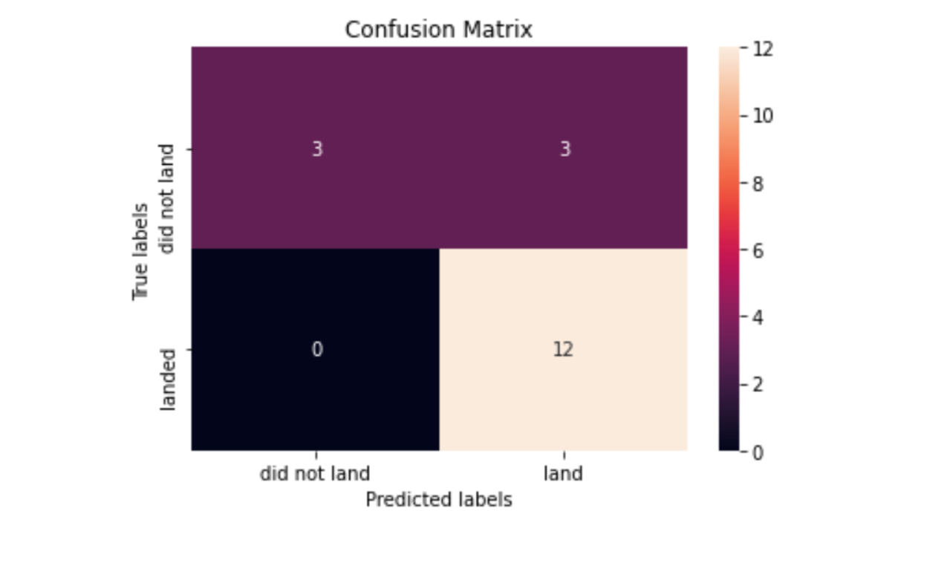
Confusion Matrix
From the confusion matrix for the best performing model i.e Decision Tree , we can observe that False positives are the one causing error.

Slide 45
Conclusions
Decision Tree Model is the best algorithm for this dataset.
Launches with a low payload mass show better results than launches with a larger payload mass.
Most of launch sites are in proximity to the Equator line and all the sites are in very close proximity to the coast.
The success rate of launches increases over the years.
KSC LC-39A has the highest success rate of the launches from all the sites.
Orbits ES-L1, GEO, HEO and SSO have 100% success rate

Slide 46


